Slide 1
Performance Optimization of Ceph Messenger
Bodon Jeong, Uiseok Song
Dept. of Computer Science and Engineering
Sogang University, Seoul, Korea
Notes:
Paper PT

Slide 2
Contents
Overview
Messenger in Ceph
Detailed Analysis
Design
Q&A

Slide 3
Overview
Ceph
Massively scalable, software-define storage system
Commodity hardware with no single point of failure
Self-healing and Self-managing
Rack and data center aware
Automatic distribution of replicas
Block, Object, File
Data stored on common backend filesystems (EXT4, XFS, etc)
Fundamentally distributed via RADOS
Client access via RBD, RADOS Gateway, and Ceph Filesystem

Slide 4
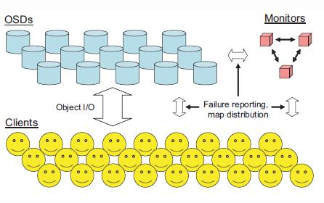
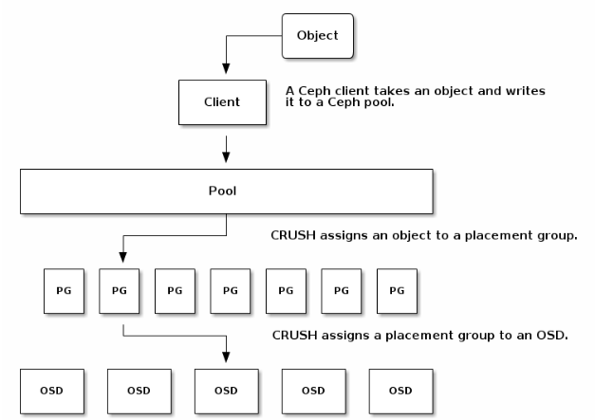
Overview(cont.)
OSD
Monitor
CRUSH
PG (Placement Group)
Replication

Slide 5
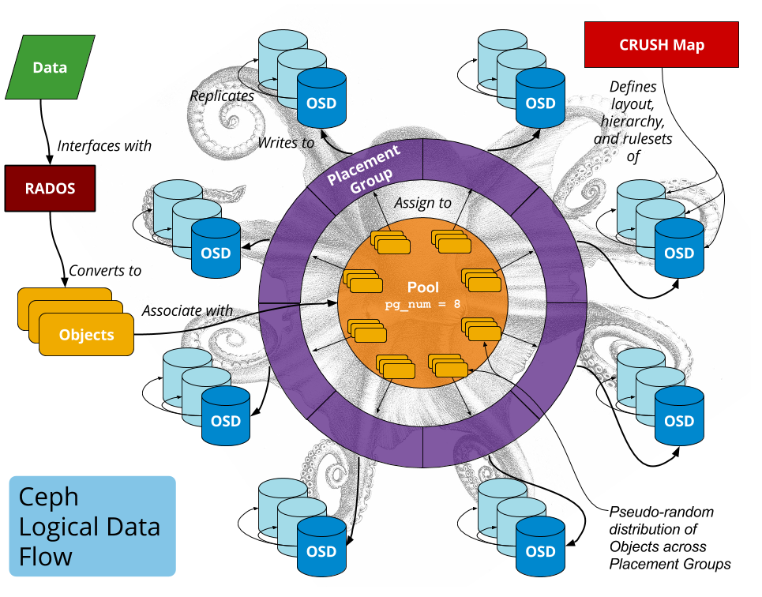
Overview(cont.)

Slide 6
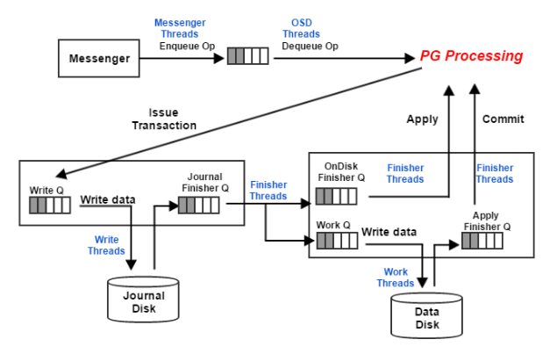
Messenger in Ceph
OSD Architecture

Slide 7
Messenger in Ceph (cont.)
Simple vs Async Messenger
Simple Messenger : threads(reader, writer, reaper, accepter ...) per pipe
Async Messenger : a worker per connection
Worker : do all jobs related to connection (accept, connect, read, dispatch, ...)
Simple Messenger
Async Messenger
Pipe 1
Worker Pool
Reader
Writer
Worker 1
Connection 1
Pipe 2
Worker 2
Connection 2
Reader
…
…
Writer

Slide 8
Messenger in Ceph (cont.)
Simple vs Async Messenger
Simple Messenger : a thread-based way for a thread to manage a single fd
Async Messenger : a event-driven way for a thread to manage muliple fds
Simple Messenger
Async Messenger
Epoll / Select / Kqueue
Read thread
Get file
descriptor
Add socket
descriptor
Worker
Processing
Busy waiting
fd
Processing
reader jobs
sd
Accept, Connect,
Read, Write, Decode, Dispatch,
Fast dispatch, …
Get file descriptors
fd
fd
fd
events

Slide 9
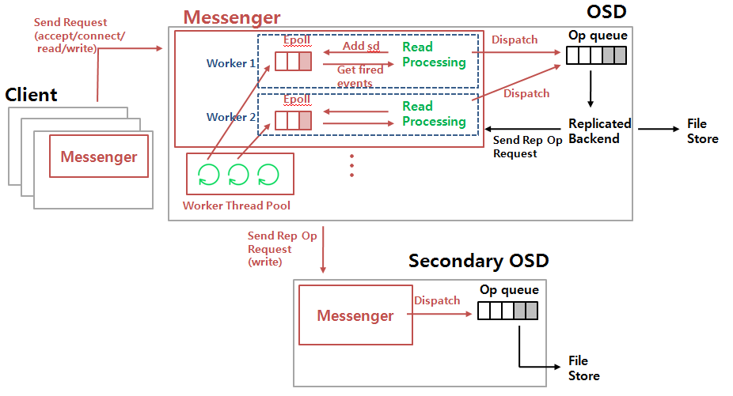
Messenger in Ceph (cont.)
Async Messenger Architecture

Slide 10
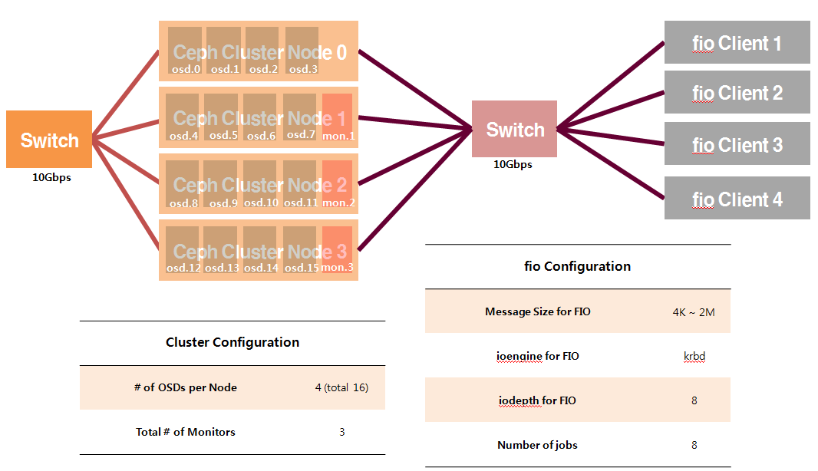
Detailed Analysis
Testbed

Slide 11
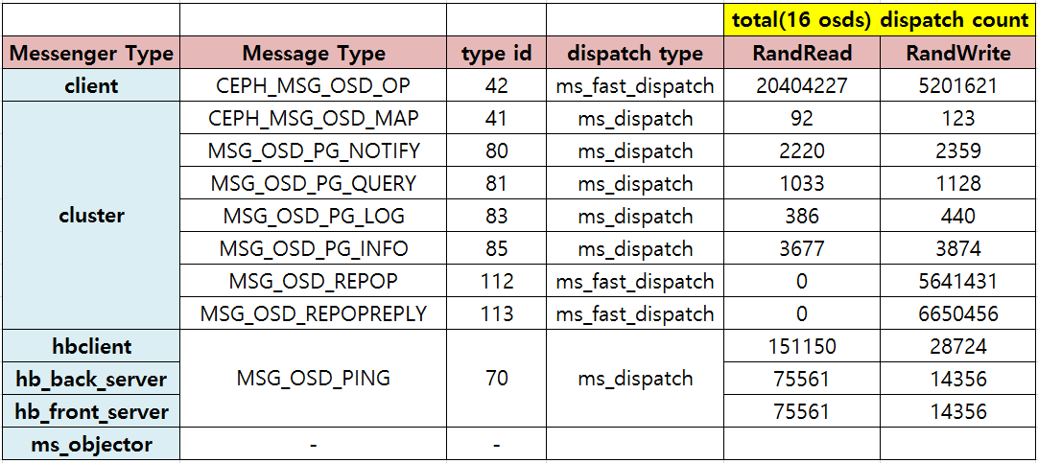
Detailed Analysis (cont.)
REPOP and REPOPREPLY are replication messages
Client–Cluster connection and Cluster–Cluster connection are data intensive connections
Need to optimization in specific connections

Slide 12
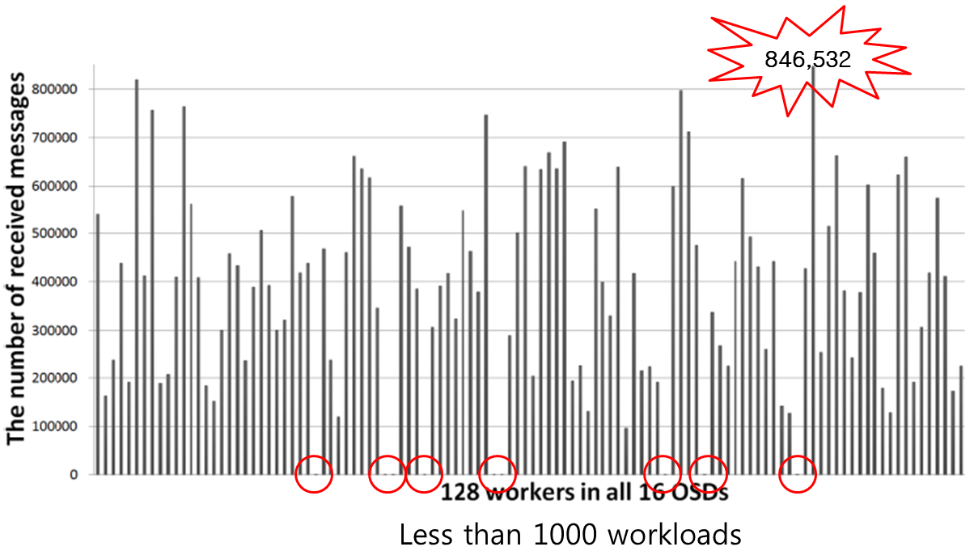
Detailed Analysis (cont.)
The amount of messages processed by each worker is different and the differnece is large -> load imbalance
Need load balance algorithm for workers

Slide 13
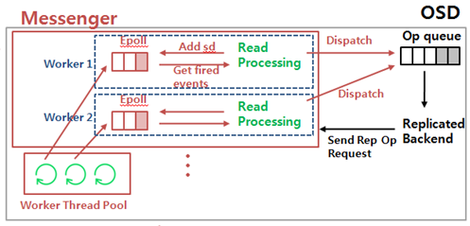
Detailed Analysis (cont.)
One worker assigned to a connection performs the above read Processing
Read Data -> Decode -> Etc -> Fast Dispatch

Slide 14
Detailed Analysis (cont.)
msg size 4K |  |  |  |  | msg size 2M
randread |  |  |  |  | randread
 | total(sec) | average(usec) | % |  |  | total(sec) | average(usec) | %
Process | 30.9273 | 31.1938 | 100.0000 |  | Process | 0.4298 | 50.6995 | 100.0000
Read | 2.5542 | 2.5762 | 8.2586 |  | Read | 0.0680 | 8.0202 | 15.8190
Read Data | 0.0044 | 0.0044 | 0.0141 |  | Read Data | 0.0001 | 0.0112 | 0.0221
Decode | 2.6648 | 2.6877 | 8.6163 |  | Decode | 0.0644 | 7.5989 | 14.9881
Etc | 6.3824 | 6.4374 | 20.6369 |  | Etc | 0.0894 | 10.5493 | 20.8074
Dispatch | 17.4437 | 17.5940 | 56.4023 |  | Dispatch | 0.1887 | 22.2572 | 43.9001
msg size 4K |  |  |  |  | msg size 2M
randwrite |  |  |  |  | randwrite
 | total(sec) | average(usec) | % |  |  | total(sec) | average(usec) | %
Process | 76.5585 | 62.1290 | 100.0000 |  | Process | 127.1510 | 5721.0799 | 100.0000
Read | 23.1126 | 18.7564 | 30.1895 |  | Read | 126.0030 | 5669.4263 | 99.0971
Read Data | 14.8976 | 12.0898 | 19.4591 |  | Read Data | 125.3200 | 5638.6952 | 98.5600
Decode | 4.0927 | 3.3213 | 5.3459 |  | Decode | 0.1348 | 6.0670 | 0.1060
Etc | 10.9502 | 8.8863 | 14.3030 |  | Etc | 0.3071 | 13.8163 | 0.2415
Dispatch | 35.8873 | 29.1234 | 46.8757 |  | Dispatch | 0.6549 | 29.4668 | 0.5151
1. fast Dispatch and the rest have no dependency
2. In read(4k~2M) and small size write(4k) processing, fast dispatch takes about 40~50%
Can be parallalized in this processing

Slide 15
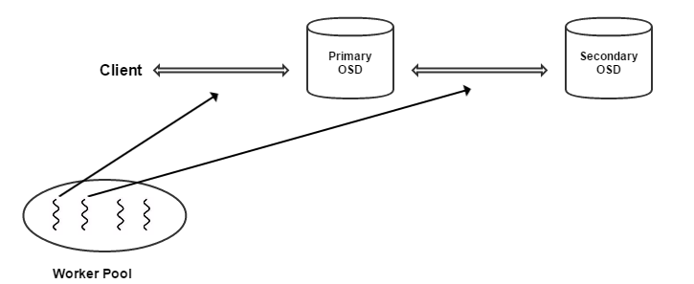
Design
Original Structure

Slide 16
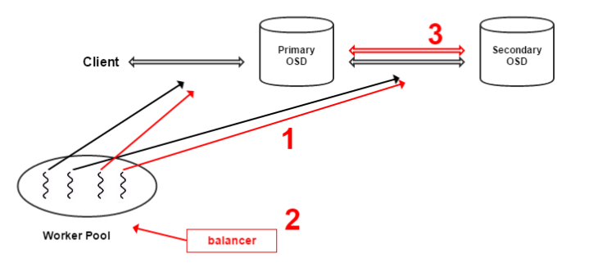
Design (cont.)
1. read2 : assign additional worker to specific connection to achive parallelism
2. load-balancing : monitor amount processed by the worker and rearrange the worker to connection
3. multi-connection : construct additional connection between clusters to speed up processing replication messages

Slide 17
Q&A

